Slide 1
ENVIRONMENTAL CASE STUDIES
CASE STUDIES & IMPACT

Slide 2
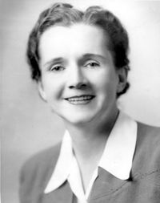

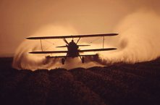
The whistle blowers
1873 – first synthetic insecticide
Paul Herman Muller- 1939
1948 – US / Nobel
1962 - Publication
1972 - Ban
2000 – Stockholm convention
Crop dusting – National archives

Slide 3
The Stockholm Convention on Persistent Organic Pollutants, the International Program on Chemical Safety
The dirty dozen: UNEP
Insecticides & Pesticides: Aldrin, Chlordane, DDT, Dieldrin, Endrin, Heptachlor, Hexachlorobenzene, Mirex
Toxaphene, Hexachlorobenzene
Industrial Chemicals
Polychlorinatedbiphenyls,Dioxins
Furans

Slide 4
Nine new chemicals have been added to the list
On 8 May 2009, the Conference of the Parties (COP) added nine more chemicals as persistent organic pollutants.
Pesticides: - 1.chlordecone, 2.lindane, 3.pentachlorobenzene;
4.alpha hexachlorocyclohexane and beta hexachlorocyclohexane,
Industrial chemicals:-5.hexabromobiphenyl ( hexabromodiphenyl ether and heptabromodiphenyl ether), 6.pentachlorobenzene, 7.perfluorooctane sulfonic acid, its salts and 8. perfluorooctane sulfonyl fluoride, 9.tetrabromodiphenyl ether and pentabromodiphenyl ether; and
By-products: - alpha hexachlorocyclohexane, beta hexachlorocyclohexane and pentachlorobenzene
Short-chained chlorinated paraffins ,Endosulfan, and Hexabromocyclododecane may be added to this list. Still debatable.

Slide 5
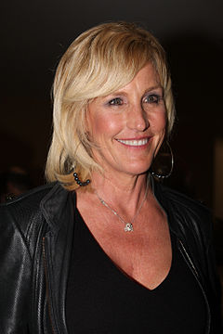
1993 - Pacific Gas and Electric Company (PG&E), California.
Contamination of drinking water with hexavalent chromium in the southern California town of Hinkley
The Hinkley compressor station, a part of a natural-gas pipeline connecting to the San Francisco Bay Area.
Between PG&E hexavalent chromium used to fight corrosion in the cooling tower (1952 – 1966).
Wastewater discharged to unlined ponds - percolated into the groundwater
Case settled in 1996 for US$333 million - the largest settlement ever paid in a direct-action lawsuit in US history.
Erin Brockovich

Slide 6
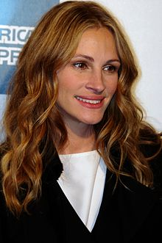
The true story of Erin Brockovich was made as a biographical film where the character of Erin Brockovich, was portrayed by Julia Roberts

Slide 7
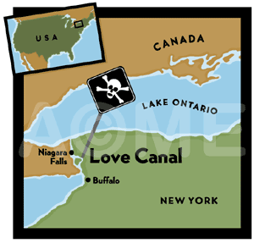
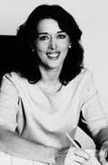
The whistle blowers
William T Love – 1880
Hooker chemical company
1947-1952 – 20,000 metric tons
1952 – the one dollar deal
Jan 1954
1978 - 82 chemicals / dozen carcinogens
1980 – Declared disaster zone
President Jimmy Carter issued an order allowing the paid evacuation of the 900 families living at Love Canal and started the process that has become known as Superfund, to clean up other hazardous sites across the country
1987 - EPA
LOIS GIBBS
Center for Health, Environment and Justice

Slide 8
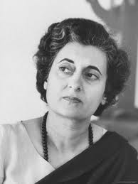
Awareness in India
1972-Stocklom convention
attended by late Prime minister Mrs.Indira Gandhi
Need felt for Institutional frame work
Department of Environment was created.
Need felt for legal/Regulatory frame work
Control & Prevention of pollution Act-1974
Central Pollution Control Board set up
State pollution control board set up

Slide 9
Bhopal Gas tragedy – Worlds worst Industrial disaster -1984
An American dream turned Indian nightmare
http://www.youtube.com/watch?v=rJg19W8x_Ls
MIC – Liquid dynamite
Dangerous when mixed with water
Medical officer Kukum Saxena’s caution – Ignored, Out of Job

Slide 10
Bhopal Gas tragedy – on the fateful day
Cleaning storage pipes
Worksheet lacked vital information
Slip bind
Water mixed with MIC – temperature rise
First breach - cooling system breaks
Smell first indication of danger
Temperature in tanks rise to 200 ⁰C
Second level breached
Gas curber neutralizes MIC with caustic soda – left on standby
Third breach
Safety alarm switched off shortly to avoid panic
Fourth breach
The flag tower not working
Gas blowing towards city
Silent killer on the loose

Slide 11
Disaster struck Mayhem in the middle of the night
Union Carbide never made it public what to do in the event of a leak / emergency do’s/don’ts – MIC - Level -4 chemical
Never told plant managers about catastrophic events that could be caused in the event of leakage – UC safety report never communicated
Company did not give composition of gas or any antidote
Union carbide tells that the gas MAY BE an eye irritant
Advices use of milk, eggs, water and eye drops!!!!!!! As treatment
Doctors left in dark
Pulmonary Oedema - Fluid filled collapse of lungs – identified from autopsies

Slide 12
Official documents registered
Deaths – 3000, Others 9000, 500,000 exposed to gases
Doctor of Union Carbide releases press statement: conventional cough syrups and eye drops, Effects will recede in maximum 3 weeks
Even today
Birth defects, fertility impairments, 7 times more miscarriages in Bhopal as compared to national average, gastro-intestinal, lung and skin cancers highly reported, long-term effects on central nervous system -poor coordination, partial blindness, paralysis
10, 000 more deaths in later years
One death every day in Bhopal linked to after effects of Bhopal gas tragedy
Company avoids culpability, claims sabotage
Warren Anderson – released within few hrs of arrest due to intervention by US
India still seeks extradition of him on manslaughter charges

Slide 13
Post Bhopal gas tragedy
Department was converted to ministry
1986 - Environment Protection Act (by ministry)
Rules were made for:
Hazardous waste
Chemical accidents
Emergencies-preparedness and response
Biomedical waste
Plastic waste

Slide 14
Global commitment
In the words of The Norwegian Nobel Committee
“We honour the earth; for bringing forth flowers and food – and trees… is committed to the protection of the earth. This commitment is our vision – deeply felt and connected to human rights and peace”.
Honouring the IPCC through the grant of the Nobel Peace Prize in 2007 – A Clarion call for the protection of the earth

Slide 15
Noble speech….
This choice is, an acknowledgement of 3 important realities ……
The power and promise of collective scientific endeavour,
The role of knowledge in shaping public policy and guiding global affairs for the sustainable development of human society.
An acknowledgement of the threats to stability and human security inherent in the impacts of a changing climate and, therefore, the need for developing an effective rationale for timely and adequate action to avoid such threats in the future.

Slide 16
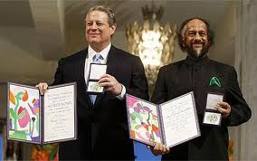
The Nobel Peace Prize 2007
Al Gore, Ex.VP, USA & R K Pachouri representing IPCC as it’s Chairman

Slide 17
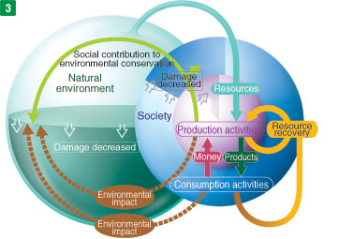
Course objective
Awaken Eco - ‘logical’ sense and trigger pro environmental approach in action, incorporating simple solutions in day to day developments

Slide 18
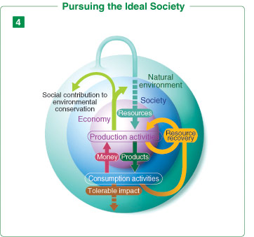
The ideal scenario

Slide 19
International Environmentalists
Charles Darwin-
Ralph Emerson
Henry Thoreau
John Muir
Aldo Leopold
Rachel Carson
EO Wilson

Slide 20







Organizations working for Environment
World Wide Fund (WWF)
Centre for Science and Environment (CSE)
Central Pollution Control Board (CPCB)
Wildlife Institute of India (WII)
United Nations Environment Program (UNEP)

Slide 21
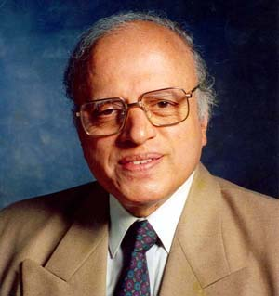
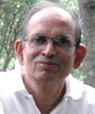

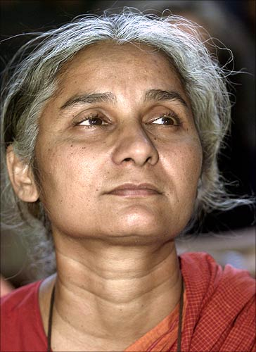
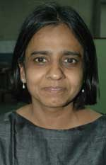
Indian Environmentalists

Slide 22
Some Indian environmentalists
Salim Ali - Orinthology
Indira Gandhi - Played an important role in preserving wild life
SP Godrej - Padma Bhusan
MS Swaminathan - Agricultural scientist
Madhav Gadgil - Ecologist
MC Mehta - Environmentalist Lawyer
Anil Agarwal - Journalist
Medha patekar - Narmada dam
Sunderlal Bahugana - Chipko Movement

